Slide 1

Microprocessor & Computer Architecture (μpCA)
UE23CS251B
Session - 5

Slide 2
Microprocessor & Computer Architecture (μpCA)
UE23CS251B
Branch Instructions &
Addressing Modes

Slide 3
Branch / Flow Control Instructions
Syntax: B{<cond>} Label
BL{<cond>} Label
BX{<cond>} Rm
BLX{<cond>} Rm
B | Branch | Program Counter = Label
BL | Branch & Link | Step1: PC will be copied to R14 the Link Register (LR) before branch is taken. Step2: Program Counter = Label
BX | Branch Exchange | Used for changing ARM to Thumb mode or from Thumb mode to ARM mode.
BLX | Branch Exchange with link

Slide 4
Flow Control Instructions
Branch Instruction- (Unconditional)
B label
…
label: …
Conditional Branch Instruction
MOV R0, #0
loop: …
ADD R0, R0, #1
CMP R0, #10
BNE loop

Slide 5
Flow Control Instructions
Exercise-1: Program to find the sum of N NUMBERS ( use conditional branch ).
Store the result in memory location.
Program:
.DATA
A: .WORD 10,20,30,40,50,60,70,80,90,100
SUM: .WORD 0
.TEXT
LDR R1,=A
LDR R2,=SUM
MOV R4,#0 ; INITIALISATION
MOV R5,#1 ; COUNT register
L1: LDR R3, [R1]
ADD R4,R4,R3 ; Add next element in the array.
ADD R1, R1, #4 ; address to the next data
ADD R5, R5, #1 ; increment the count register
CMP R5, #11 ; Check whether all numbers are added
BNE L1 ; Else branch to L1 location
STR R4,[R2] ; store the result in location SUM.
SWI 0X011 ; logical end of the program.

Slide 6
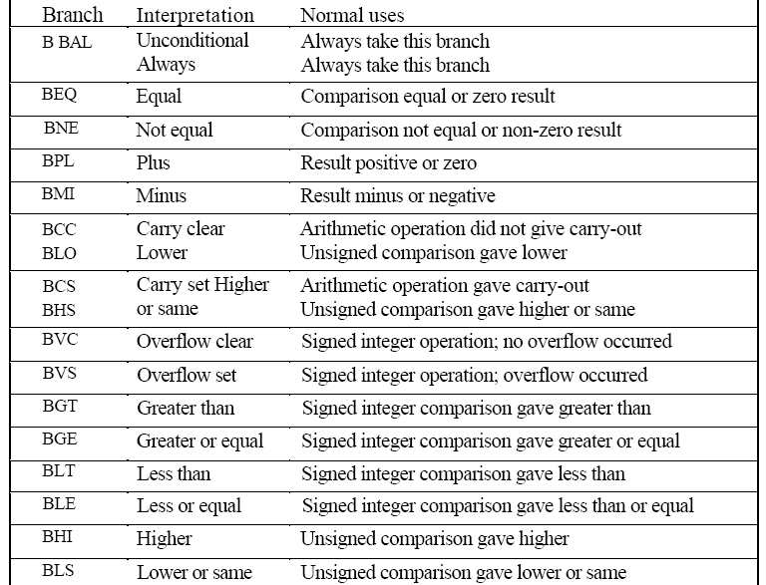
Conditional Branch Options

Slide 7
Addressing Half Words
Program to find the sum of N numbers using half word
.DATA
A: .HWORD 0x10,0x20,0x30,0x40,0x50,0x60,0x70,
0x80,0x90, 0x0100
SUM: .WORD 00
.TEXT
LDR R1,=A
LDR R2,=SUM
MOV R4,#0 ;INITIALISATION
MOV R5,#1 ;COUNT
L1: LDRH R3,[R1]
ADD R4,R4,R3
ADD R1,R1,#2
ADD R5,R5,#1
CMP R5, #11
BNE L1
STRH R4, [R2]
SWI 0X011

Slide 8
Addressing Byte Data
Program to find the sum of N numbers using Byte Data
; SUM OF N NUMBERS
; DATA GIVEN
.DATA
A: .BYTE 1,2,3,4,5,6,7,8,9,10
SUM: .word 0
.TEXT
LDR R1,=A
LDR R2,=SUM
MOV R4,#0 ;INITIALISATION
MOV R5,#1 ;COUNT
L1: LDRB R3,[R1]
ADD R4,R4,R3
ADD R1,R1,#1
ADD R5,R5,#1
CMP R5, #11
BNE L1
STRB R4,[R2]
SWI 0X011

Slide 9
Addressing memory locations
Memory is addressed by a register and an offset.
LDR R0, [R1] @ mem[R1]
Three ways to specify offsets:
Immediate
LDR R0,[R1,#4] @ mem[R1+4]
Register
LDR R0,[R1,R2] @ mem[R1+R2]
Scaled Register
LDR R0,[R1,R2,LSL #2] @ mem[R1+4*R2]

Slide 10
Addressing Modes of ARM Architecture
Preindexing or Preindexing without writeback
Preindexing with Writeback or Autoindexing
Post indexing

Slide 11
Syntax of Addressing Modes used in ARM Architecture
Pre Indexing Without Write Back
Syntax: LDR Rd, [Rn, OFFSET]
Pre Indexing With Write Back
Syntax: LDR Rd, [Rn, OFFSET]!
Poste Indexing
Syntax: LDR Rd, [Rn] ,OFFSET

Slide 12
Operand specified in register
Pre-indexed addressing
LDR R0, [R1, R2] @ R0=mem[R1+R2]
@ R1 unchanged
Auto-indexing addressing
LDR R0, [R1, R2]! @ R0=mem[R1+R2]
@ R1=R1+R2
Post-indexed addressing
LDR R0, [R1], R2 @ R0=mem[R1]
@ R1=R1+R2
Will improve the coding style.

Slide 13
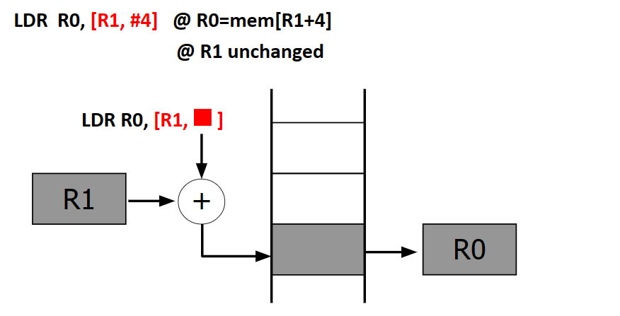
Pre-index addressing

Slide 14
Example – Using preindexing addressing mode
Program to find the sum of N NUMBERS
Store the result in memory location.
Program:
.DATA
A: .WORD 10,20,30,40,50,60,70,80,90,100
SUM: .WORD 0
.TEXT
LDR R1,=A
LDR R2,=SUM
MOV R4,#0 ; INITIALISATION
MOV R5,#1 ; COUNT register
L1: LDR R3, [R1, #4]
ADD R4,R4,R3 ; Add next element in the array.
ADD R1,R1,#4 ; useless
ADD R5, R5, #1 ; increment the count register
CMP R5, #11 ; Check whether all numbers are added
BNE L1 ; Else branch to L1 location
STR R4,[R2] ; store the result in location SUM.
SWI 0X011 ; logical end of the program.
Has no impact on the preindexing mode....

Slide 15
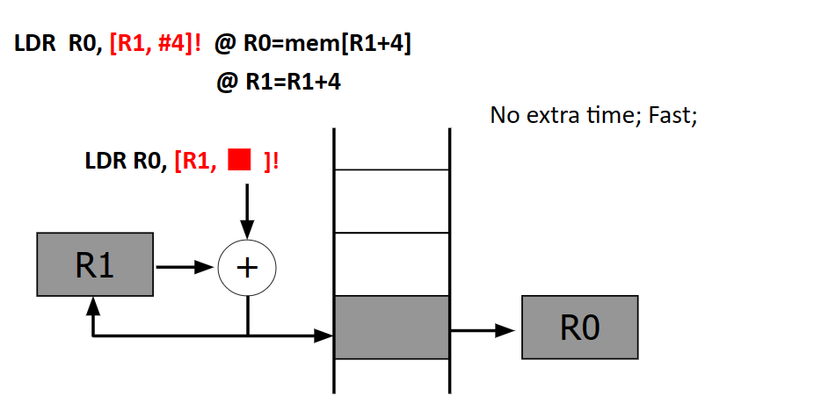
Auto-indexing addressing or Preindexing with writeback

Slide 16
Example – Using preindexing with writeback or autoindexing addressing mode
Program to find the sum of N NUMBERS
Store the result in memory location.
Program:
.DATA
A: .WORD 10,20,30,40,50,60,70,80,90,100
SUM: .WORD 0
.TEXT
LDR R1,=A
LDR R2,=SUM
MOV R4,#0 ; INITIALISATION
MOV R5,#1 ; COUNT register
L1: LDR R3, [R1,#4]!
ADD R4,R4,R3 ; Add next element in the array.
ADD R5, R5, #1 ; increment the count register
CMP R5, #11 ; Check whether all numbers are added
BNE L1 ; Else branch to L1 location
STR R4,[R2] ; store the result in location SUM.
SWI 0X011 ; logical end of the program.

Slide 17
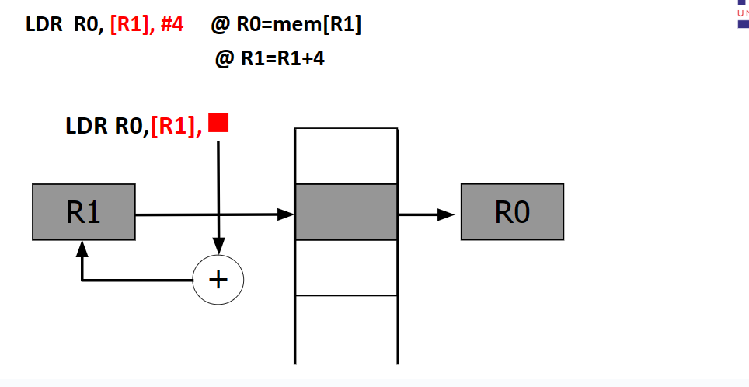
Post-index addressing

Slide 18
Example – Using postindexing Addressing Mode
Program to find the sum of N NUMBERS and Store the result in memory location.
Program:
.DATA
A: .WORD 10,20,30,40,50,60,70,80,90,100
SUM: .WORD 0
.TEXT
LDR R1,=A
LDR R2,=SUM
MOV R4,#0 ; INITIALISATION
MOV R5,#1 ; COUNT register
L1: LDR R3, [R1], #4
ADD R4,R4,R3
ADD R5,R5,#1
CMP R5, #11
BNE L1
STR R4,[R2]
SWI 0X011

Slide 19

THANK YOU
Team MPCA
Department of Computer Science and Engineering

